Slide 1

Can we use Image Classification for Commercial Fish Processing?
Composed by: Alex Blaies

Slide 2

Problem Statement
Objective:
To develop a generalized, predictive model that can identify and differentiate between different types of fish species that share similar characteristics. The ideal model has a myriad of potential use cases that include the following:
High volume fish processing plant: ability to dynamically identify and separate different (in tandem with robotics) fish species to optimize the handling and processing of fish
Use for identification of fish species for environmental conservation efforts: this would require augmentation of the existing model to account for different environmental contexts
Potentially leverage existing model to develop a more sophisticated model that can accurately measure the dimensions (length and width) of the fish as well as the weight
Criteria for Success:
Accurately predict > 90% of the test images
Reduce overfitting and balance the various metrics (recall, precision, etc.)

Slide 3
Problem Statement Continued
Scope of solution space
Leverage public dataset to construct a generalized model that can accurately predict various species of fish from a collection of images
Key data sources:
Kaggle fish dataset: https://www.kaggle.com/crowww/a-large-scale-fish-dataset/code

Slide 4
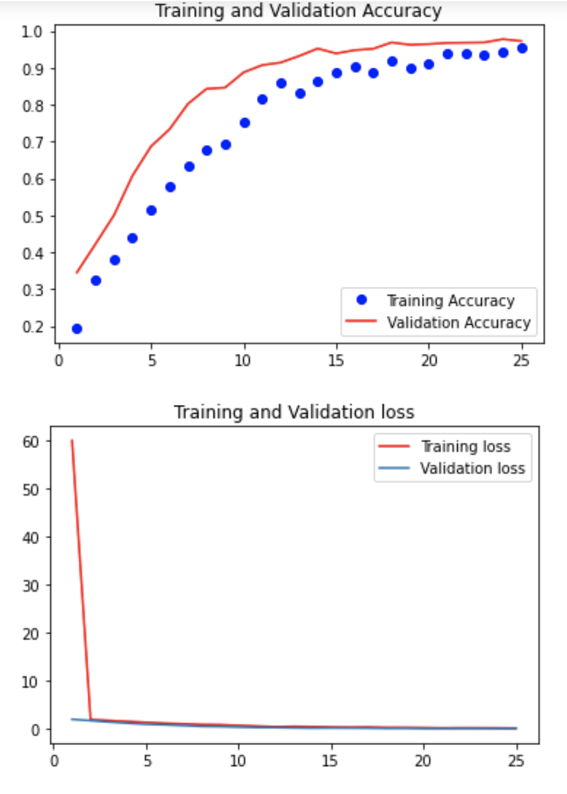
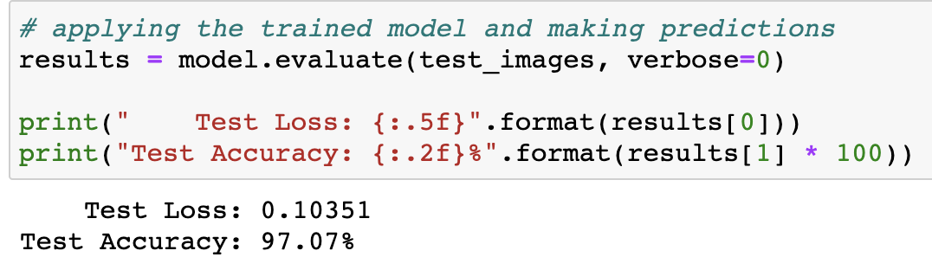
Key Findings
What justifies the potential Premium?
Based on the classification model, it looks like we can accurately identify and label various types of fish
Overfitting was minimized
The model could be further optimized based with additional hyperparameter tuning

Slide 5
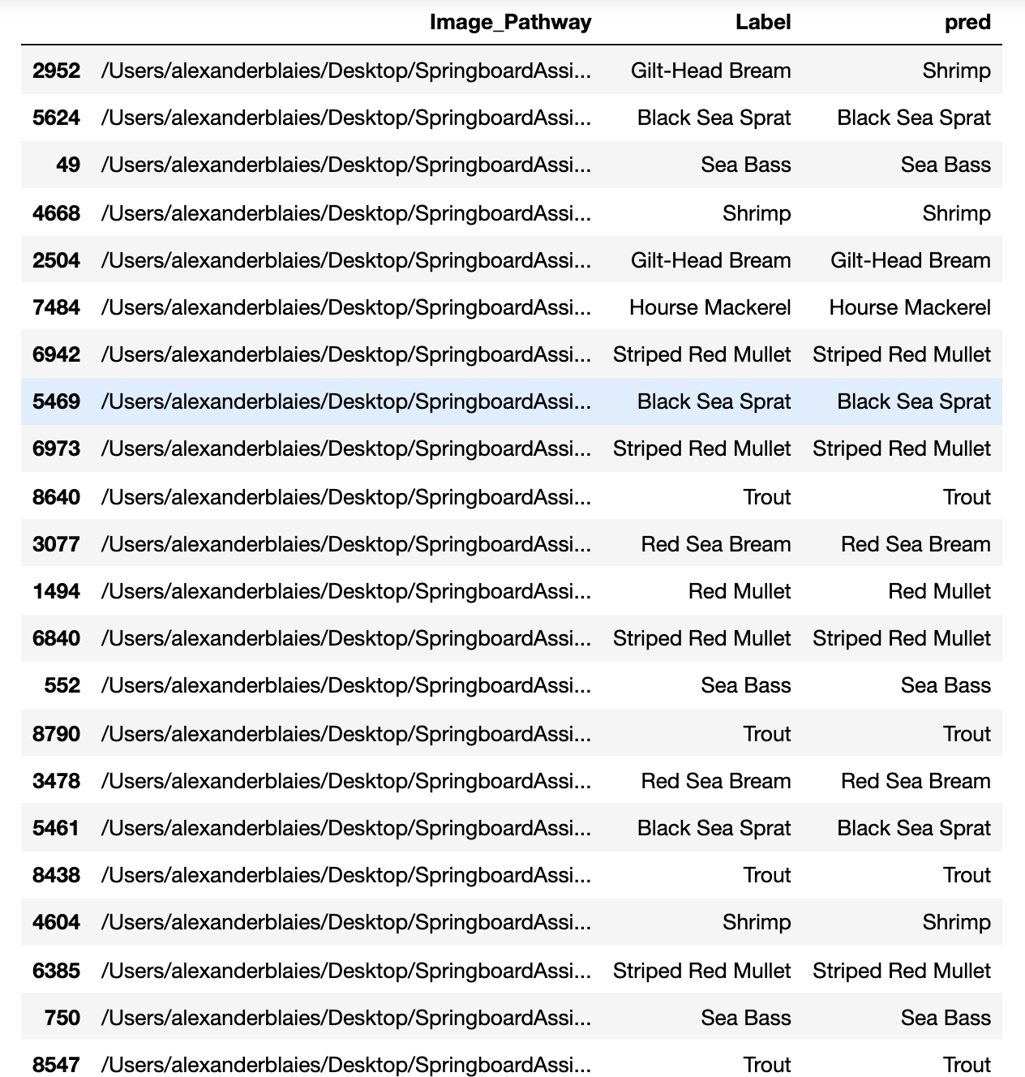
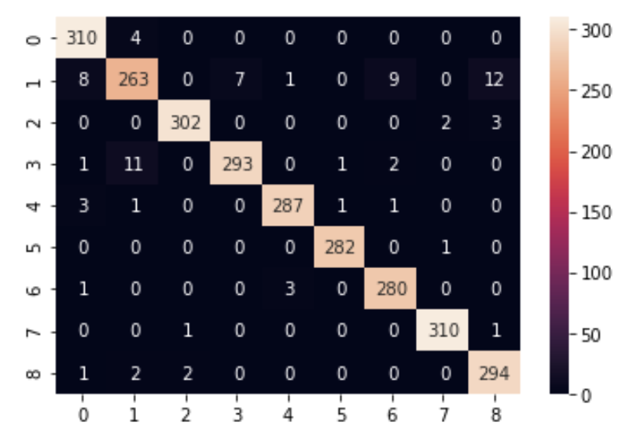
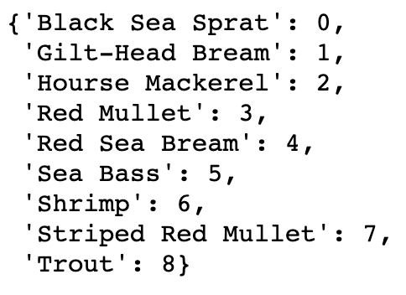
Key Findings Continued
Label = Ground Truth/Actual
Pred = Predicted Label

Slide 6
Recommendations
Build upon this model to include other fish and different contexts
Because the contexts (background noise) was somewhat uniform throughout the dataset, this could pose a problem if you wished to identify a fish in water for example
In combination with other technologies (robotics), you can apply this classification model to optimize operational processes at processing plants

Slide 7

Thank You

